Slide 1

Email Triage Agent
Generative AI based Email Classification & Response
Presented by Sumit Mishra — a concise overview for product managers and engineering teams evaluating an AI email triage solution.

Slide 2

Problem Statement
1
2
High volume of emails
Manual processing is slow
Inboxes are flooded with requests, updates, and notifications that consume team time.
Human review creates bottlenecks and inconsistent triage decisions across teams.
3
Important emails may be missed
Critical issues can slip through, increasing risk and degrading customer experience.

Slide 3
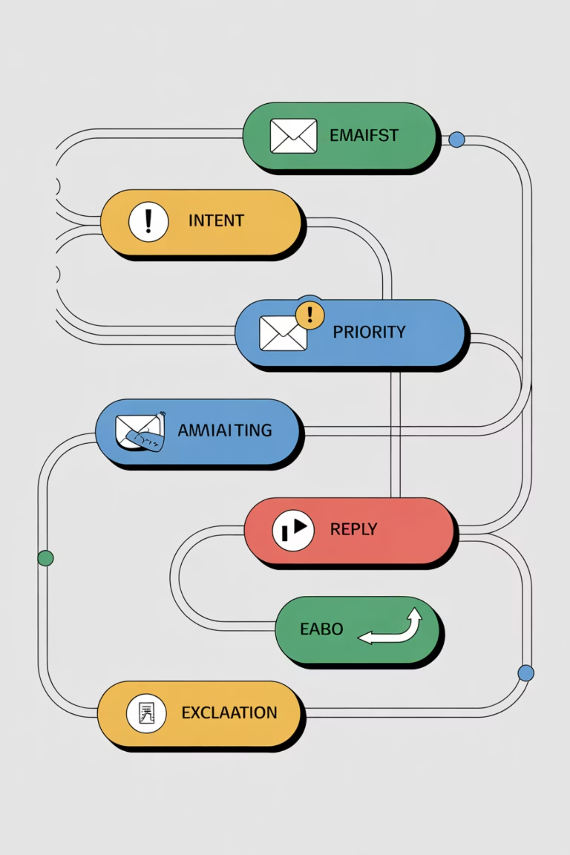
Proposed Solution
Intent Detection
Classify incoming messages by purpose (support, billing, feedback, security) using transformer-based models.
Priority Assignment
Score urgency and business impact to route messages into low / medium / high lanes.
Auto Reply Generation
Generate concise, context-aware replies with editable templates and confidence metadata for human review when needed.
Escalation
Automatically escalate critical or uncertain items to on-call engineers or product owners with conversation summary and suggested actions.

Slide 4
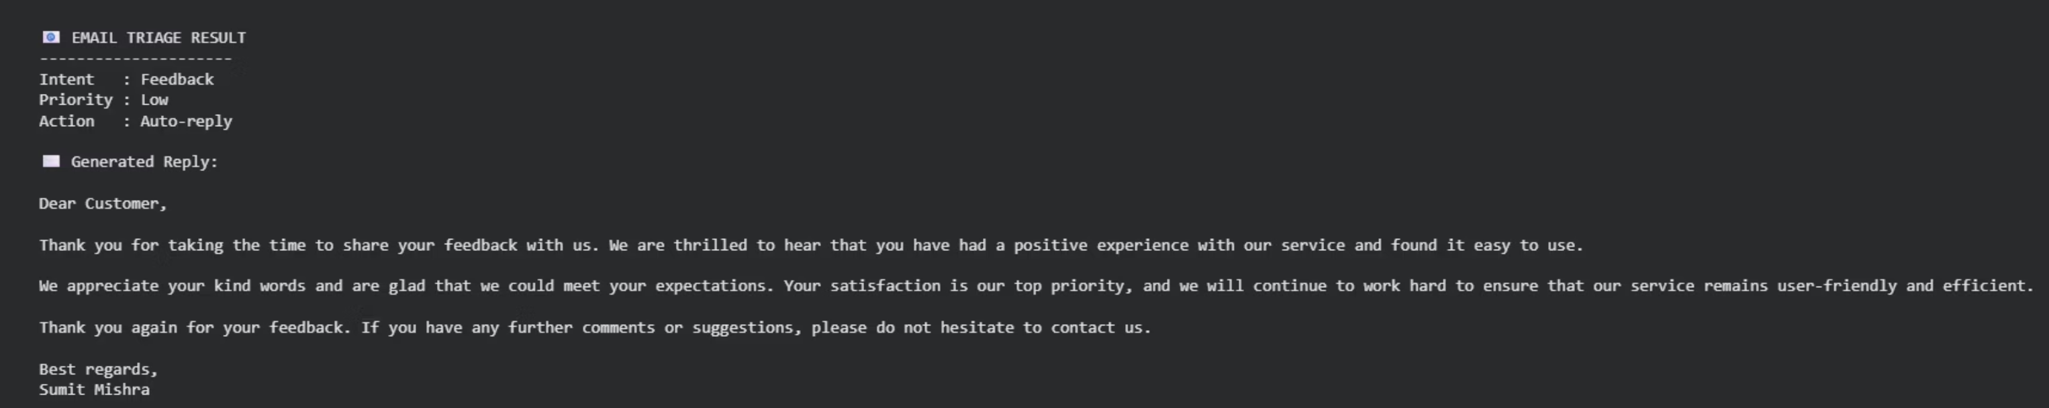

Low Priority — Auto Reply Workflow
Automatic handling for routine requests (FAQ, scheduling, acknowledgements). Workflow:
Detect intent → match template
Insert personalized fields (name, ticket ID)
Send immediate auto-reply with next steps
Archive or label for metrics and review
Design for transparency: include confidence score and edit option for each auto-generated reply.

Slide 5
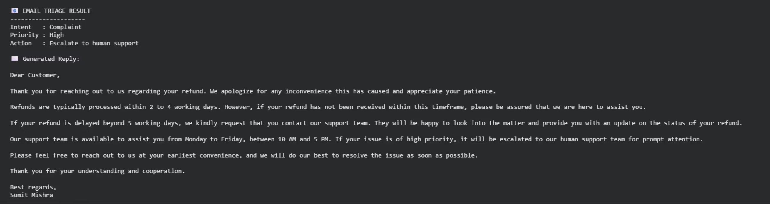
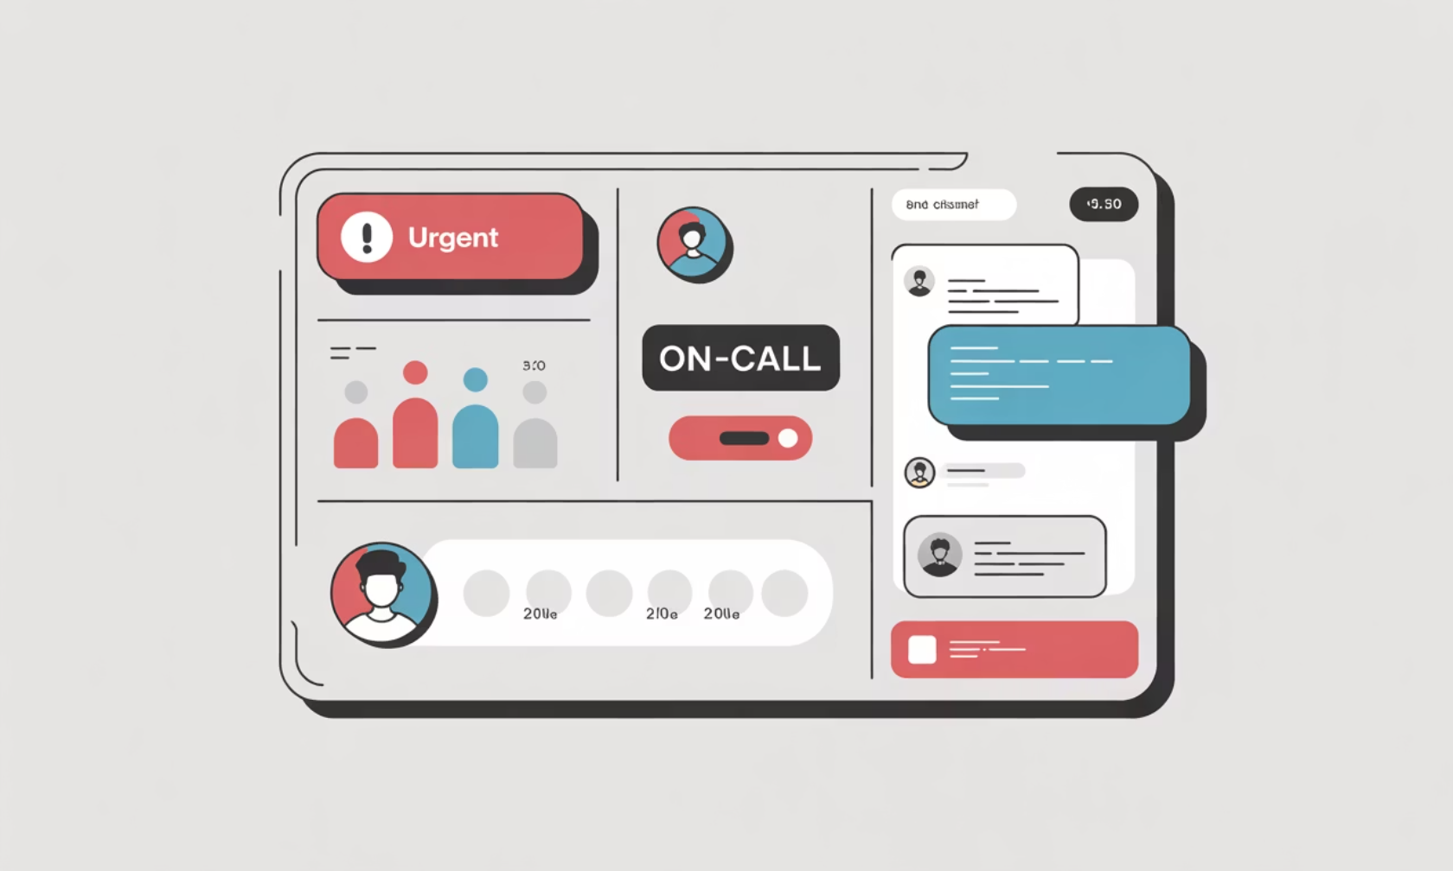

High Priority — Escalation Flow
Critical messages require immediate human attention. Escalation steps:
Auto-detect critical intent or low confidence
Generate compact summary + root-cause hints
Attach relevant context (attachments, previous threads)
Notify on-call via Slack/email with direct link
Prioritize safety: configurable rules and override paths ensure correct routing for security or legal incidents.

Slide 6

Conclusion & Next Steps
Automates email handling
Improves response speed
Clear decision logic
Reduces manual triage and repetitive responses by routing predictable traffic to automated flows.
Immediate replies and prioritized escalation lower time-to-resolution for customers and internal teams.
Transparent confidence scores, audit trails, and rules make outcomes explainable and auditable.
Student-level & industry relevant
Architecture supports research-grade models while meeting production constraints for reliability and compliance.
Suggested next steps: pilot with a focused mailbox, collect metrics (precision, recall, MTTR), iterate templates and escalation rules, then scale.

